Slide 1

Team Details:
a. Code Monkeys
b. Muhammad Abubakar (Team Leader)
c. Problem Statement:
Planning travel currently requires navigating numerous disparate websites and apps for flights, accommodation, transport, and activities. This fragmented process is time-consuming, complex, and often results in a stressful and inefficient booking experience for travelers.

Slide 2
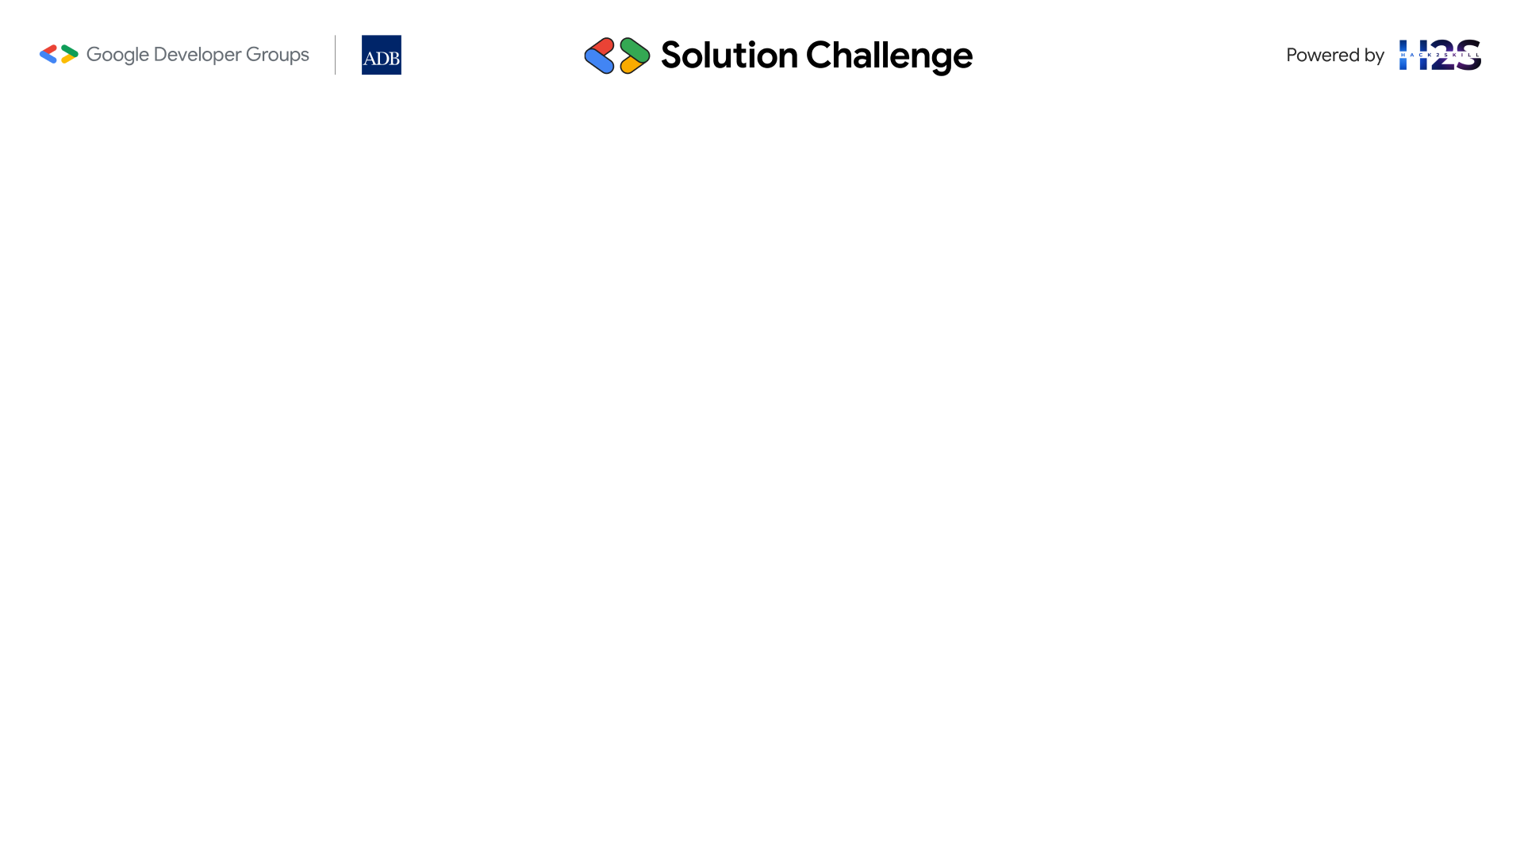
Brief about solution:
What it is: A web-based, comprehensive Tourism Dashboard frontend application.
Core Functionality: Centralized platform to explore, plan, and book travel.
Key Goal: Simplify trip organization through a unified interface.
User Experience: Clean, responsive design for all devices.

Slide 3
Opportunities:
Integrated Platform: Combines flights, tourism, transport, visa, and hotels.
Unified User Experience: Consistent flow across booking types.
Curated Content: Seasonal Highlights, Trending Packages.
Direct Support: Integrated chat bot for assistance.
Solving the Problem:
• Reduces complexity and saves time.
• Improves user experience with intuitive interface.
• Provides inspiration and support.
f) USP: All-in-one travel planning & booking dashboard with chat bot.

Slide 4
List of features offered by the solution:
Navigation: Persistent top navigation bar.
Homepage: Hero section, Seasonal Places, Trending Packages.
Booking Modules: Flights, Tourism, Transport, Visa, Hotel, Best Packages.
Support: Integrated Chatbot.
UI/UX: Responsive design, modern components, animations, consistent theme.

Slide 5
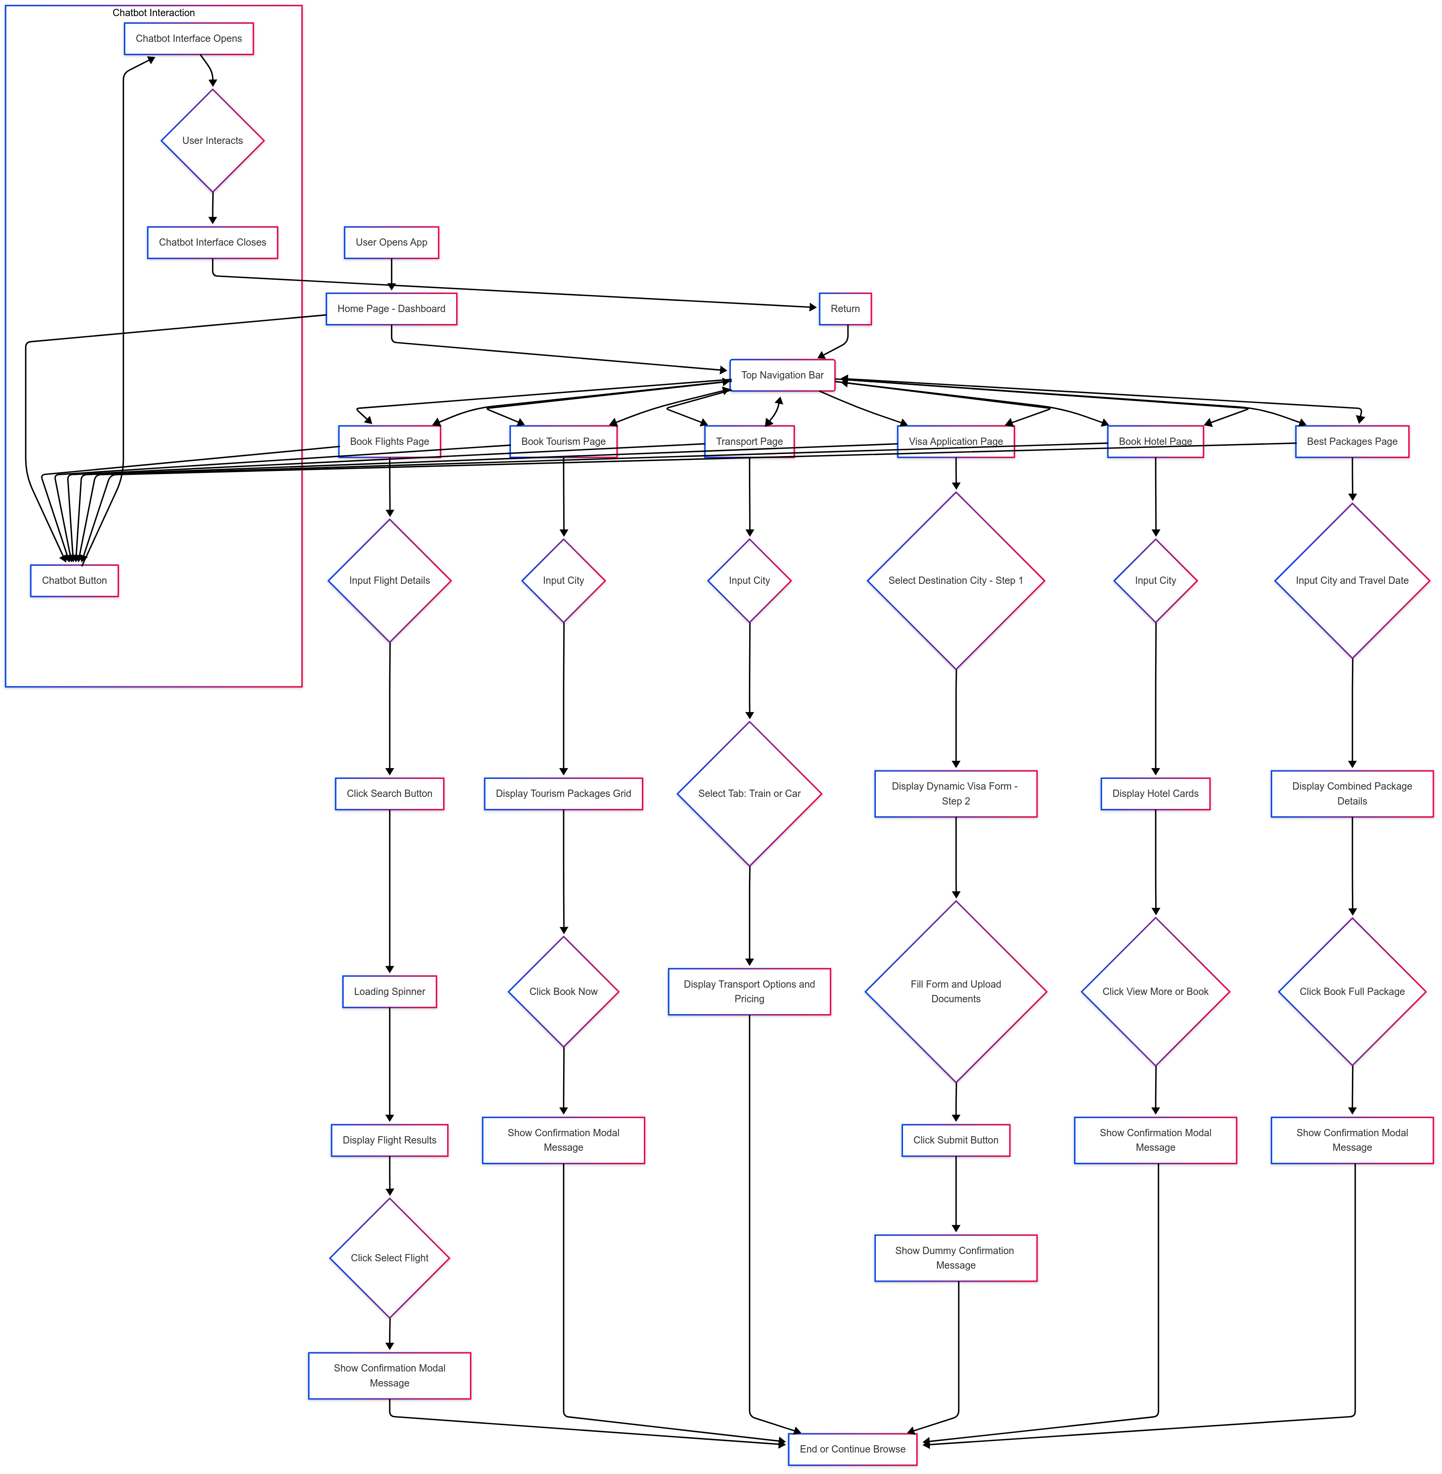
Process flow diagram or Use-case diagram:

Slide 6
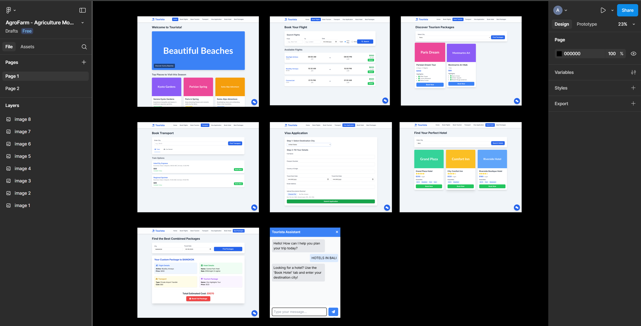
Wireframes/Mock diagrams of the proposed solution:

Slide 7
Technologies to be used in the solution
(Mandatory to integrate Gemini APIs)
Frontend: HTML5, CSS (Tailwind), JS, Font Awesome, Google Fonts.
Future Enhancements:
• Frontend Frameworks: React, Vue.js, Angular.
• Backend: Node.js, Python, Java, etc.
• Database: PostgreSQL, MongoDB, etc.
• APIs: Booking, Payment, Visa, etc.
• Cloud: AWS, GCP, Azure.
• Advanced Features: ML recommendations, analytics.

Slide 8
Not included in frontend code.
Cost Factors:
• Scope and complexity.
• Technology stack.
• Team size and experience.
• Design and UI/UX.
• Third-party API fees.
• Infrastructure and maintenance.
• Marketing and user acquisition.
Estimated implementation
cost:

Slide 9
Snapshots of the prototype

Slide 10
Provide links to your:
Demo video link:
https://drive.google.com/file/d/1y11IZ-Csb_jl05-McSbg0vny_AxVsVgk/view?usp=sharing
Working prototype link:
https://www.figma.com/design/Oq5XzGkN28UtkjK1CG5tZQ/AgroFarm--- Agriculture-Mobile-App--Community-?fuid=1178052345715157147

Slide 11
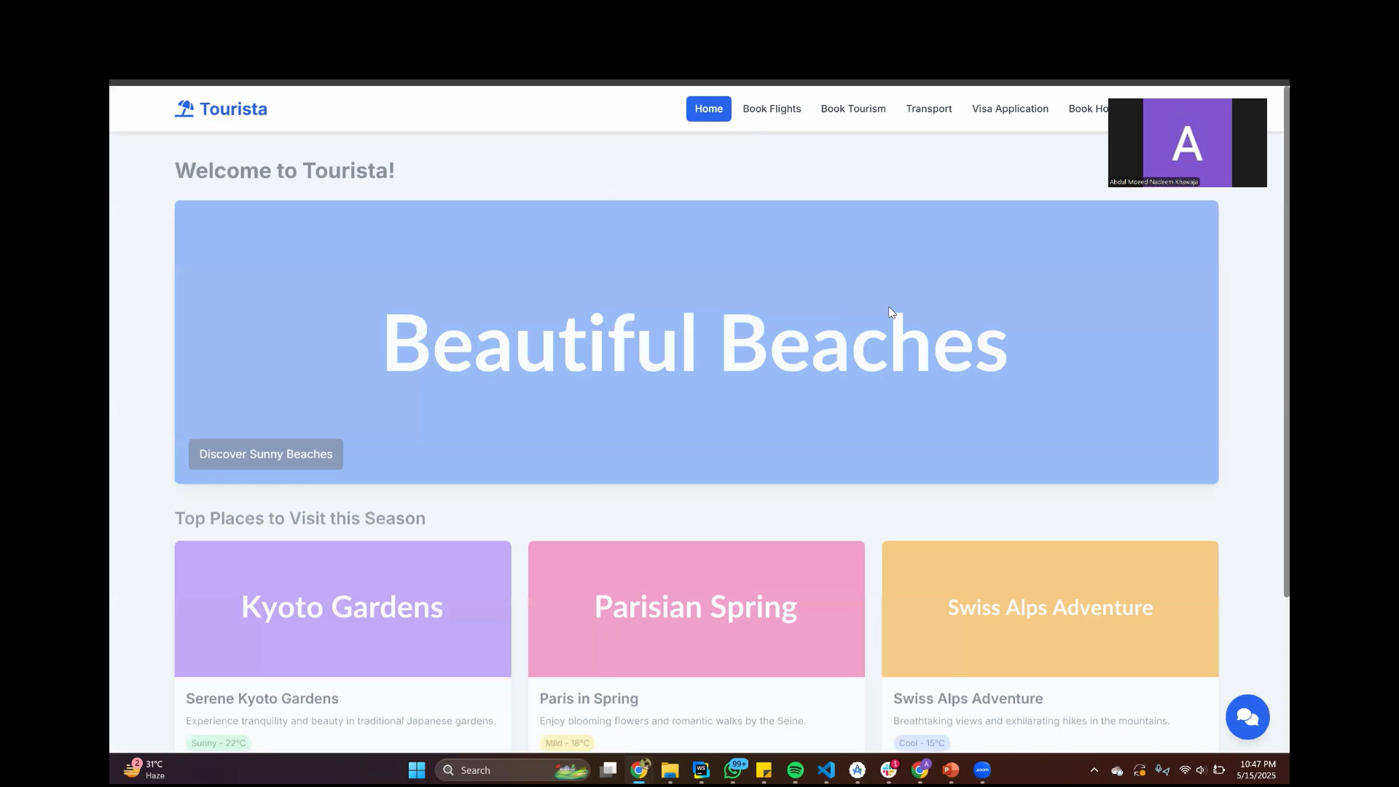

Slide 12


